Slide 1

Body Fat Prediction
Stat 628 Module 1 by Group7(wed)

Slide 2
Part 1 Introduction
Dataset:
Percentage of body fat + other 14 physical measurements of 252 men.
Goal:
Propose a linear model to predict body fat.

Slide 3
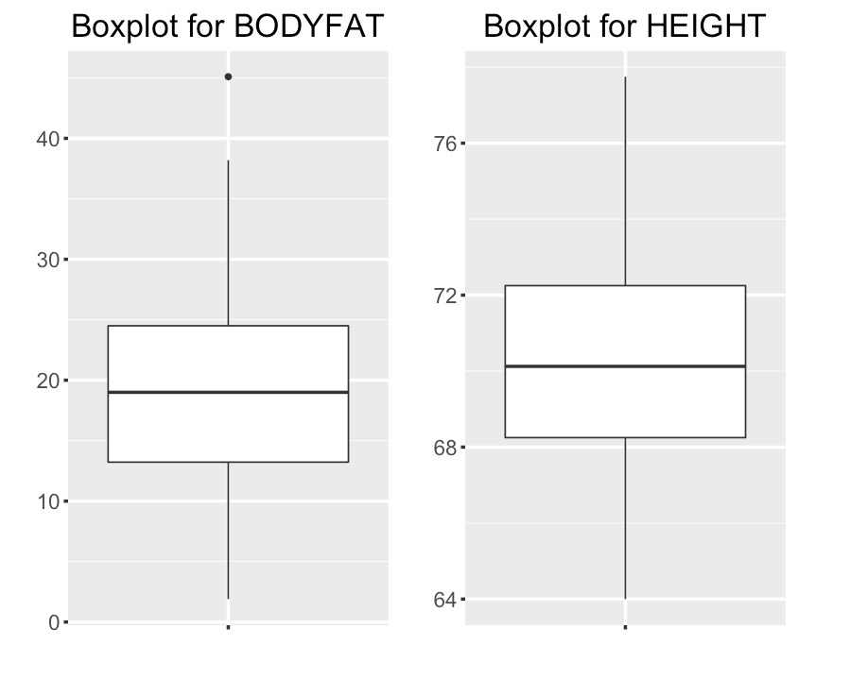
Part 2: Data Cleaning
Boxplot of raw data:

Slide 4
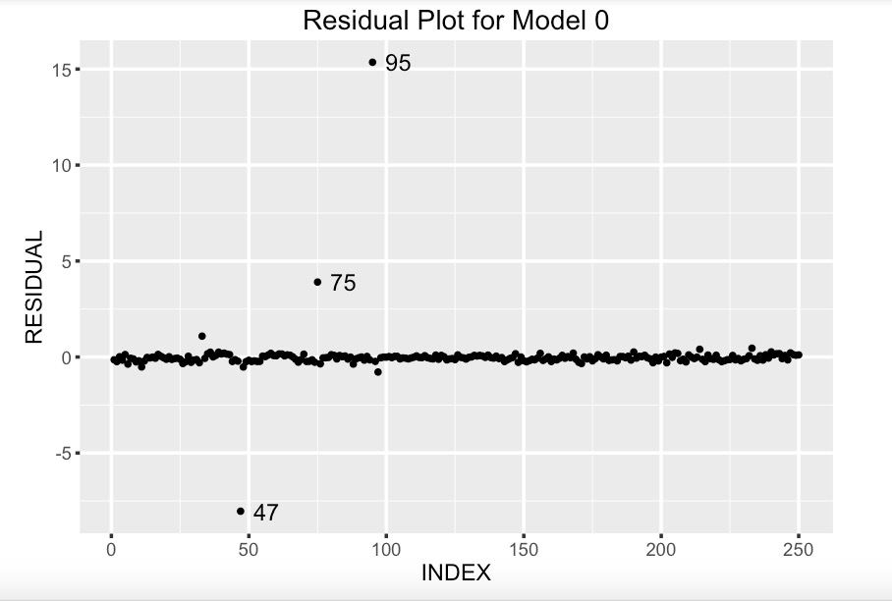

Part 2: Data Cleaning
Consistence of BODYFAT versus DENSITY:
$Bodyfat=β_{0}+β_{1}\frac{1}{Density}$

Slide 5
Part 2: Data Cleaning
Now let’s look into these three points.
 | Recorded BodyFat | Estimated BodyFat by Formula
Record No.95 | 9.6 | 0.4
This is too small, impossible!

Slide 6
Part 2: Data Cleaning
Compare with a correctly recorded point No. 24:
The recorded BodyFat is more reasonable, we stick to that one.
 | Recorded BodyFat | Estimated BodyFat by Formula
Record No.75 | 18.3 | 14.1

Slide 7
Part 2: Data Cleaning
Compare with a correctly recorded point No. 24:
The estimated BodyFat is more reasonable, we change it to that one.
 | Recorded BodyFat | Estimated BodyFat by Formula
Record No.47 | 6.4 | 14.1

Slide 8
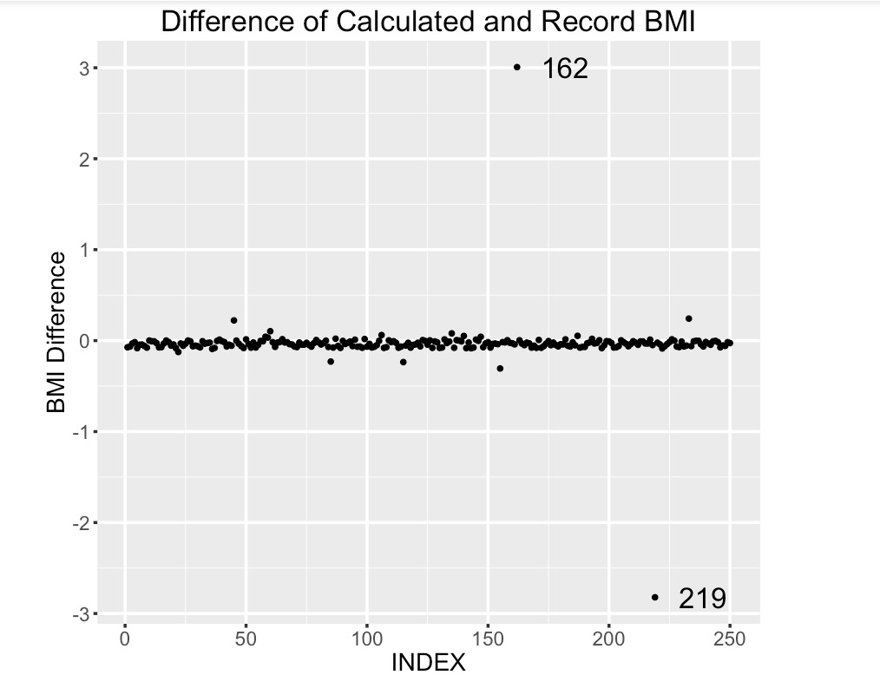

Part 2: Data Cleaning
Consistence of BMI versus HEIGHT and WEIGHT:
$BMI= \frac{weight(kg)}{height(m^{2})}$
These two points are excluded.

Slide 9
Part 3: Variable Selection
Method | Selected Variables | Method | Selected Varibles
BIC Backward | WEIGHT, ABDOMEN, FOREARM, WRIST | AIC Forward & Both | 6 variables
BIC Forward & Both | ABDOMEN, WEIGHT | Mallow's Cp | 9 variables
AIC Backward | 10 variables | LASSO | 5 variables

Slide 10
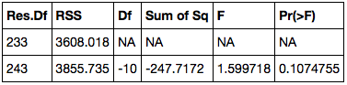
Part 3: Variable Selection
Applied ANOVA on selected models vs full model
“BIC backward” model with four variables is good enough:

Slide 11

Part 3: Variable Selection
Two reserved model:
Model 1:
$Bodyfat \sim WEIGHT+ABDOMEN+FOREARM+WRIST$
Model 2:
$Bodyfat \sim WEIGHT+ABDOMEN$

Slide 12
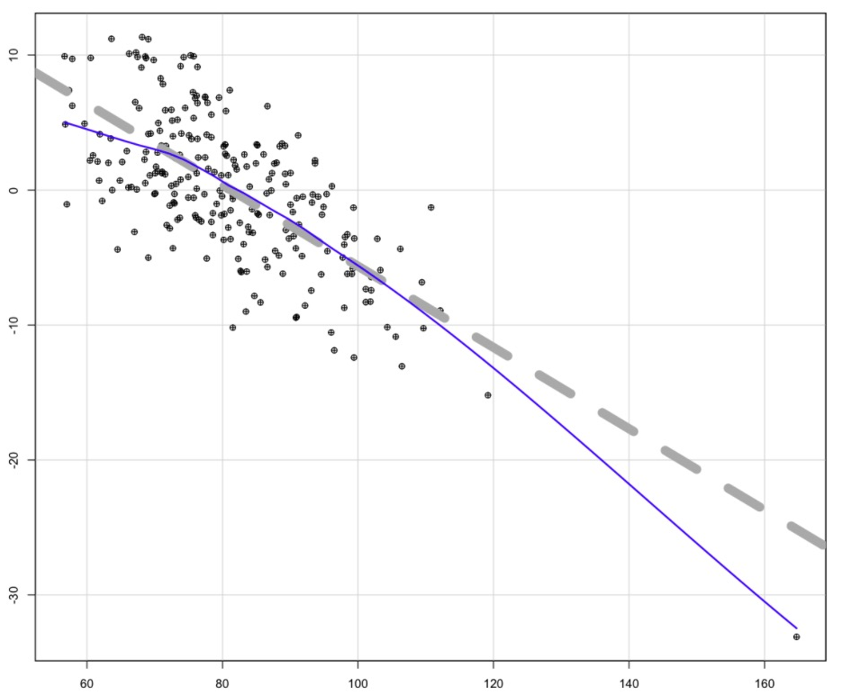
Part 4: Model Diagnostic
Component Plus Residual
For model 1:
We found that linearity assumption is not satisfied:
Weight

Slide 13

Part 4: Model Diagnostic
For model 1:
After transformation, we got:
$Bodyfat\left(\%\right)=30 −0.5WEIGHT\left(kg\right)+0.9ABDOMEN\left(cm\right)+ 0.2FOREARM\left(cm\right)−1.3WRIST\left(cm\right)−766.5WEIGHT^{\left\{−0.7\right\}}(kg)$

Slide 14
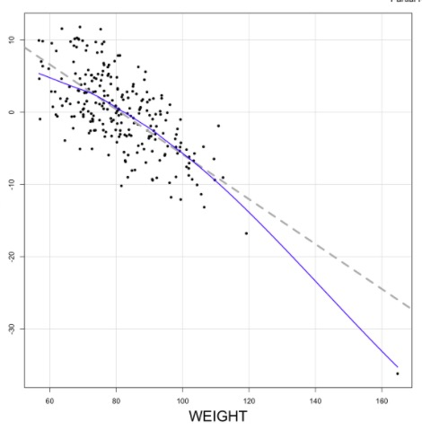
Part 4: Model Diagnostic
Component Plus Residual
For model 2:
Again, linearity assumption is not satisfied.

Slide 15

Part 4: Model Diagnostic
For model 2:
After transformation, we got:
$Bodyfat\left(\%\right)=17.42 −0.58WEIGHT\left(kg\right)+0.91ABDOMEN\left(cm\right) − 775.34WEIGHT^{\left\{−0.7\right\}}$

Slide 16
Part 5: Model Comparison and Outlier Detection
The adjusted R-square of four models we got:
They are quite similar, so we choose the simplest one!
2 variables | 2 variables with transformation | 4 variables | 4 variables with transformation
0.7398 | 0.729 | 0.7294 | 0.7168

Slide 17
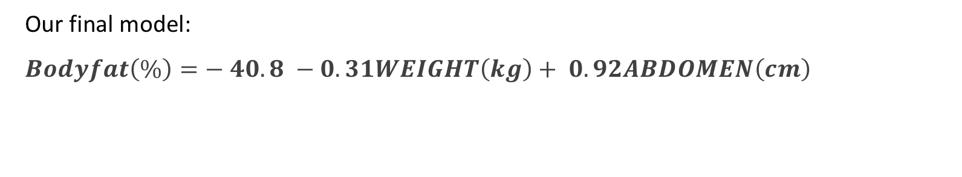
Part 5: Model Comparison & Outlier Detection
Our final model:
$Bodyfat\left(\%\right)=− 40.8 −0.31WEIGHT\left(kg\right)+ 0.92ABDOMEN\left(cm\right)$
 | Pr(>|t|)
(Intercept) | 3.75e-43
Weight | 2.90e-12
Abdomen | 2.59e-45

Slide 18
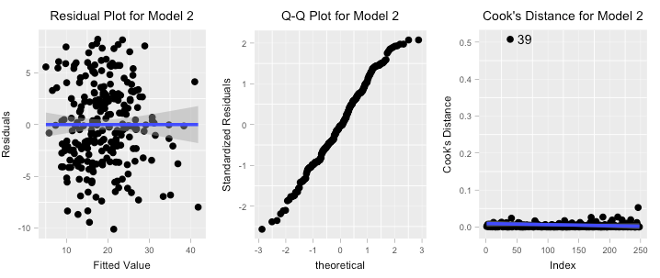
Part 5: Model Comparison and Outlier Detection

Slide 19
Part 5: Model Comparison and Outlier Detection
Test Results for Model 2 :
VIF:
Test | Null hypothesis | P-value
Normality Test | residual is normally distributed | 0.2689
Homoscedasticity Test | error's variance is constant | 0.8069476
 | WEIGHT | ABDOMEN
VIF | 4.68 | 4.68

Slide 20

Part 6: Rule of Thumb
“Multiply your weight (kg) by 0.3, add your abdomen (cm) and minus 50”
$$BodyFat(\%)=−50+ 0.3WEIGHT\left(kg\right)+ABDOMEN\left(cm\right)$$
Example:
WEIGHT (kg) | ABDOMEN (cm)
80 | 90
BodyFat
result
Precisely Estimate | 95% Confidence Interval | Rule of Thumb
17% | [16.5%, 17.5%] | 16%

Slide 21
Part 7: Strength and Weakness
Strength:
Constant Effects
Consistency of Unit
Intuitively Reasonable
Valid Model
Simplicity
Weakness:
Linearity Assumption may not satisfied
Model Suitable for Men only
Further work
Find an nonlinear model if exists.

